Slide 1
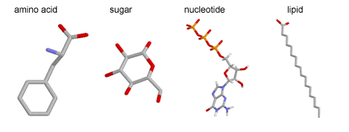
11ATAR Biology
Week 23 - Biological Molecules

Slide 2





You will be the proud new owner of a Webex Attendee account!
This means you will need to sign in to your Webex lessons instead of joining as a guest. You will need to click the ‘Sign in’ link as shown below.
How will I know what to do?
Keep an eye on your Department of Education (DOE) email – SIDE will be sending information to all students.
Visit the SIDE Website.
Your teachers/supervisors also will remind you of the new process.
What if I have issues with signing in?
Tell your teacher and email studenthelp@side.wa.edu.au.
You will still be able to join as a guest for now (the old way of joining your lessons).
But why?
This change improves security.
And once you have completed the new sign in process, getting into your lessons will be much quicker!
You will sign in with your DOE student details:
Email: username@student.education.wa.edu.au
Password: set by you
Images by Clker-Free-Vector-Images; Angelica Mariotti from Pixabay

Slide 3

Year 11 Biology Work Schedule
It is important to remain on schedule during this Semester.
Moodle
Have you visited Moodle this week? Yes / No
Tasks
Are you on schedule? Yes / No
When is your next task due?

Slide 4
Review
Decide if the following statements are TRUE of FALSE.
Charged particles must move across membranes through specific ion channels.
TRUE FALSE
A steep concentration gradient increases the rate of diffusion.
TRUE FALSE
During osmosis substances move from areas of low water concentration to high water concentration.
TRUE FALSE
A low surface area to volume ratio increases the efficiency of material transport.
TRUE FALSE
Notes:
T
T
F
F

Slide 5
Learning Intentions
Understand:
Biological molecules are synthesised from monomers to produce complex structures, including carbohydrates, proteins and lipids.
Biochemical processes in the cell are controlled by factors, including the nature and arrangement of internal membranes, and the presence of specific enzymes.
Success Criteria
Students will be able to:
Define the terms monomer and polymer.
Explain the chemical composition of proteins, carbohydrates, nucleic acids and lipids and list important biological roles of these macromolecules.
Describe anabolic and catabolic reactions.

Slide 6
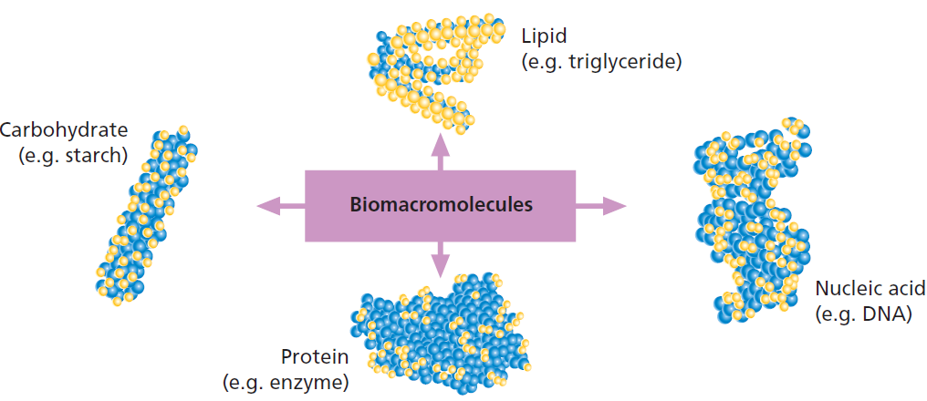
Macromolecules
Every living cell is involved in synthesising large molecules that are needed not only to build the body parts of organisms but also to maintain the biochemical processes that keep them living: communication, transforming energy and relaying genetic information.
These large molecules are called biomacromolecules.
There are four classes –
  Carbohydrate
  Lipid
  Protein
  Nucleic acid
Some organisms can make their own biomacromolecules. Others synthesise them from what they have ingested.
Autotrophs build their own organic molecules from the inorganic molecules they have taken in from their surroundings.
Heterotrophs take in organic molecules from their food.
Notes:
Some organisms can make their own biomacromolecules. Others synthesise them from what they have ingested.
Autotrophs build their own organic molecules from the inorganic molecules they have taken in from their surroundings.
Heterotrophs take in organic molecules from their food.

Slide 7
What do you know?
Simple sugars are found in carbohydrate-rich foods such as:
_________________
Fatty acids are found in lipid-based foods such as:
__________________
Amino acids are found in protein-rich foods such as:
__________________

Slide 8
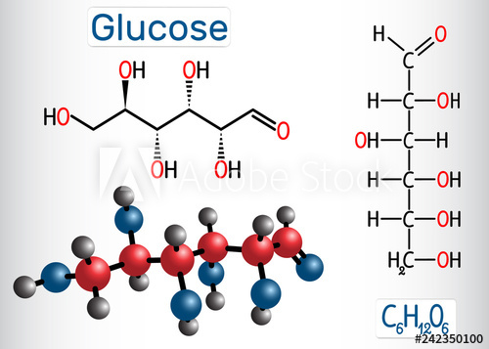
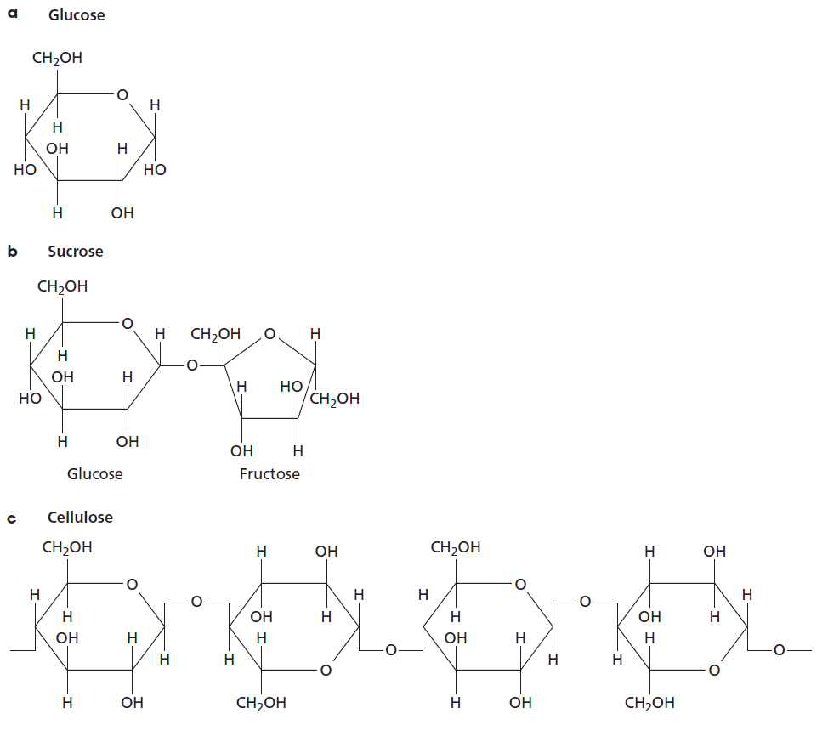
Carbohydrates
Carbohydrates are the most common compounds in living things. We see and hear about them constantly in relation to our diet.
Each molecule consists of carbon, hydrogen and oxygen atoms in the ratio of 1:2:1, giving the general formula for carbohydrates as (CH2O)n.
  Glucose C₆H₁₂O₆
Simple carbohydrates are generally called sugars.
Do you know the names of any other simple sugars?
Notes:
Sucrose, fructose, galactose, lactose, maltose

Slide 9
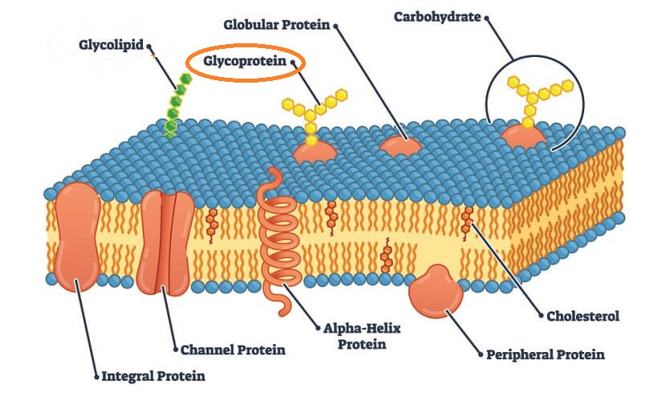
Carbohydrates
Carbohydrates are important as both energy storage molecules and as the structural elements in cells and tissues.
Carbohydrates combine with other atoms or groups to form important compounds. For example: glycoproteins.

Slide 10
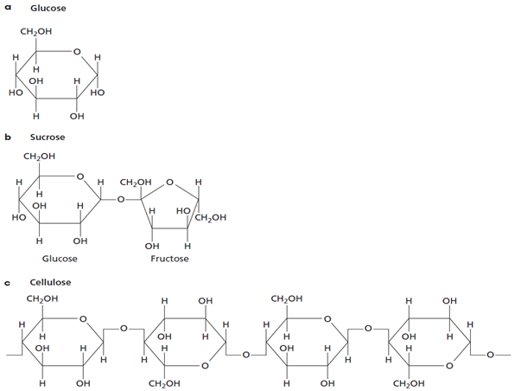
Carbohydrate structures
Classified as either monosaccharides (simple sugars), disaccharides or polysaccharides.
Monosaccharides are used as a primary energy source for fueling cellular metabolism.
Monosaccharides are single-sugar molecules. They include:
  glucose (blood sugar).
  fructose (honey and fruit juices).
A monosaccharide
A disaccharide
A polysaccharide

Slide 11
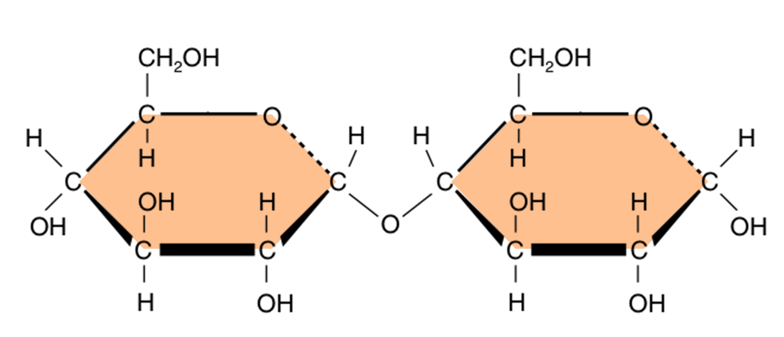
Carbohydrate structures
Disaccharides are double-sugar molecules joined with a glycosidic bond.
They are used as energy sources and as building blocks for larger molecules.
Disaccharides provide a convenient way to transport glucose.

Slide 12
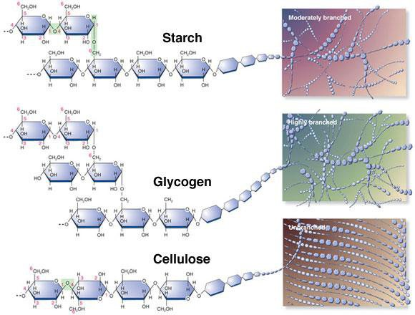
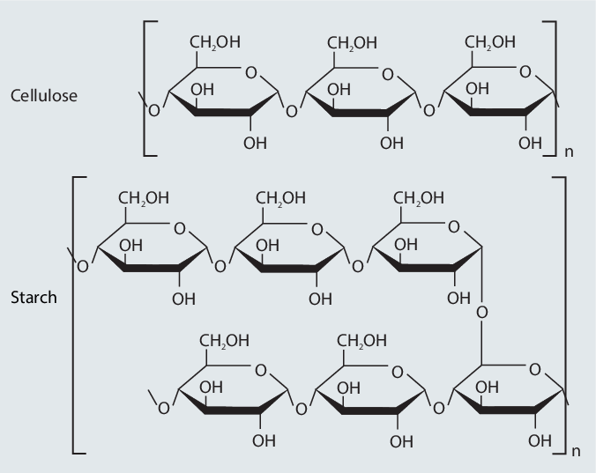
Carbohydrate structures
Polysaccharides consist of many monomers linked together.
Cellulose is a glucose polymer. It is an important structural polymer found in plant cell walls. It is made up of many unbranched chains of glucose molecules.
Starch is also a large, branched polymer of glucose. It is an energy storage molecule in plants.
Glycogen is a highly branched polymer of glucose. It is a storage form of glucose in animals.

Slide 13
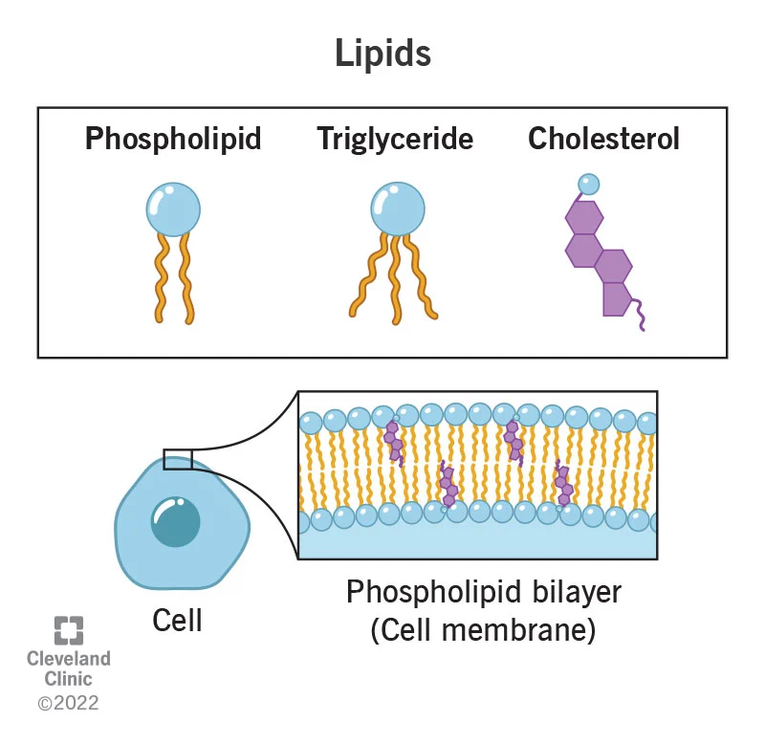
Lipids
Lipids are a diverse group of molecules and include fats and oils, terpenes, waxes, phospholipids, glycolipids and steroids.
Lipids all contain the elements carbon, hydrogen and oxygen and are insoluble in water (hydrophobic).
In cells, lipids have three important functions:
  energy storage (they have approximately twice the amount of energy as carbohydrates)
  structural component of membranes
  specific biological functions (e.g. transmission of chemical signals both within and between cells).

Slide 14
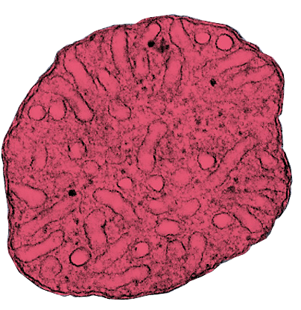
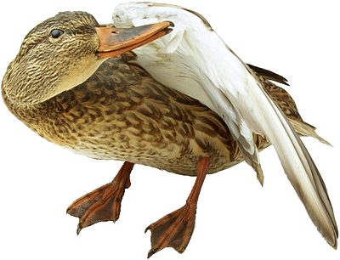
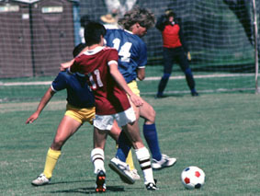
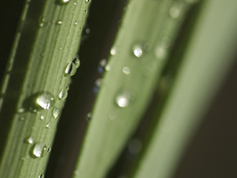
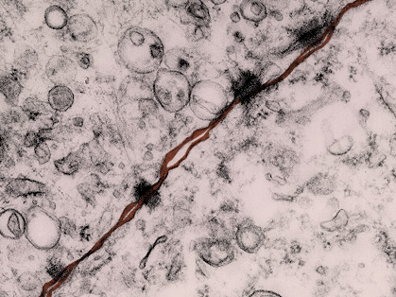
Biological Roles of Lipids
Mitochondrion (false color TEM)
Lipids are concentrated sources of energy and can be broken down (through fatty acid oxidation in the mitochondria) to provide fuel for aerobic respiration.
Waxes and oils, when secreted on to surfaces provide waterproofing in plants and animals.
Phospholipids form the structural framework of cellular membranes, e.g. the plasma membrane (above).

Slide 15
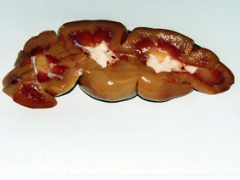
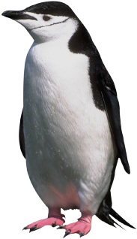
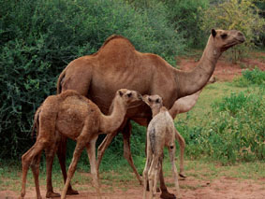
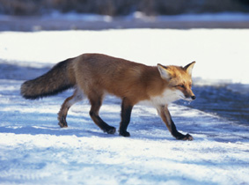
Biological Roles of Lipids
The white fat tissue (arrows) is visible in this ox kidney
Fat absorbs shocks. Organs that are prone to bumps and shocks (e.g. kidneys) are cushioned with a relatively thick layer of fat.
Lipids are a source of metabolic water. During respiration, stored lipids are metabolized for energy, producing water and carbon dioxide.
Stored lipids provide insulation in extreme environments. Increased body fat in winter reduces heat loss to the environment.

Slide 16
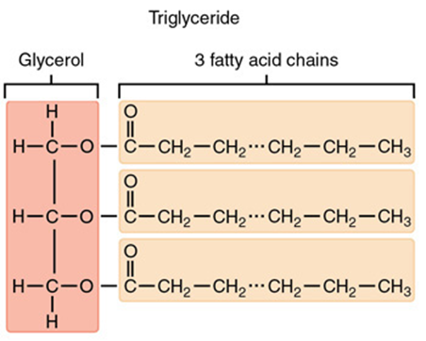
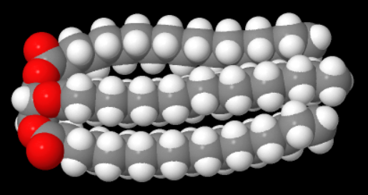

Lipid Structures
Typical lipids consist of 1-3 fatty acid chains attached to a glycerol back bone.
  One fatty acid chain = monoglyceride
  Two fatty acid chains = diglyceride
  Three fatty acid chains = triglyceride
Triglycerides are the most common of these.

Slide 17
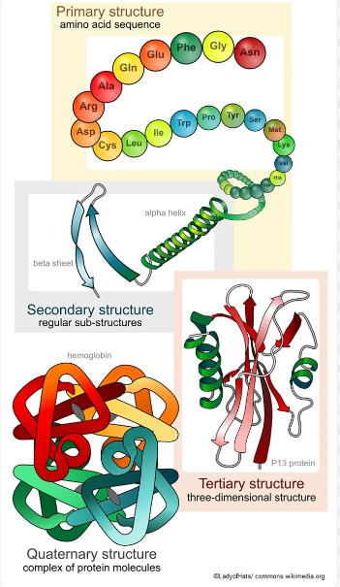
Proteins
Proteins are made up of the elements carbon, hydrogen and oxygen. However, they are different to the previous compounds in that they always contain nitrogen. In addition, sulfur is often present, and sometimes phosphorus and other elements.
These elements combine to form building blocks of proteins, amino acids. Amino acids are made into proteins in the ribosomes.
Amino acids are linked by peptide bonds to form a polypeptide chain. The order of amino acids in proteins is determined by the base sequence in genes in our chromosomes. The order determines the type of protein.
Plants can synthesise their own amino acids.
Mammals use 20 amino acids to make proteins. There are 9 essential amino acids that we can’t manufacture and must be taken from our diet.

Slide 18
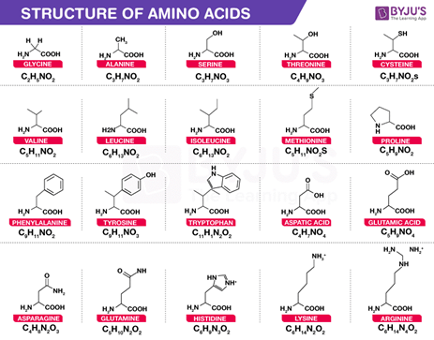
Proteins
Virtually everything a cell is, or does, depends on the proteins it contains. They contribute to building many different structures and parts and, as enzymes, control the thousands of chemical reactions that maintain life processes.
They are involved in:
      Enzyme reactions
      Structure
      Storage
      Transport
      Cell signaling
      Defense
Notes:
Body produces more than one million red blood cells each second. A range of different proteins are found embedded in the membrane of these cells e.g. channel proteins. This means that your existing RBCs need to produce proteins for 1 million plasma membranes and organelle membranes each second.

Slide 19
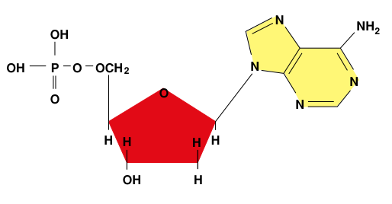
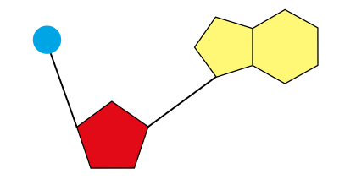
Nucleotides
A nucleotide is the basic unit of a nucleic acid. Nucleic acids are polymers made up of many nucleotides.
A nucleotide has three components:
  A phosphate group
  A sugar - Which sugar?
  A base - Which bases?
Phosphate
Base
Phosphate
Base
Sugar
Sugar
Symbolic form of a nucleotide
Chemical structure of a nucleotide

Slide 20

Learning Intentions
Understand:
biological molecules are synthesised from monomers to produce complex structures, including carbohydrates, proteins and lipids.
biochemical processes in the cell are controlled by factors, including the nature and arrangement of internal membranes, and the presence of specific enzymes.
Success Criteria
Can you:
Define the terms monomer and polymer.
Explain the chemical composition of proteins, carbohydrates, nucleic acids and lipids and list important biological roles of these macromolecules.
Describe anabolic and catabolic reactions.

Slide 21

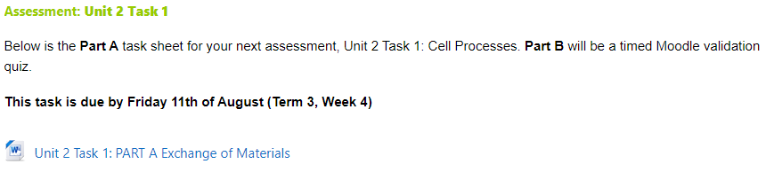
Moodle & Textbook Work
Textbook pages 253-256 & 310-312.
Academic Associates Chapter 4.3.
Trial Test 8.
Task due next week!

Slide 22
Student Feedback
What I learnt today…..
What I need to revise….

Slide 24
Quick Questions
What elements do carbohydrates contain?
State a function of lipids?
How many essential amino acids are there?

Slide 25
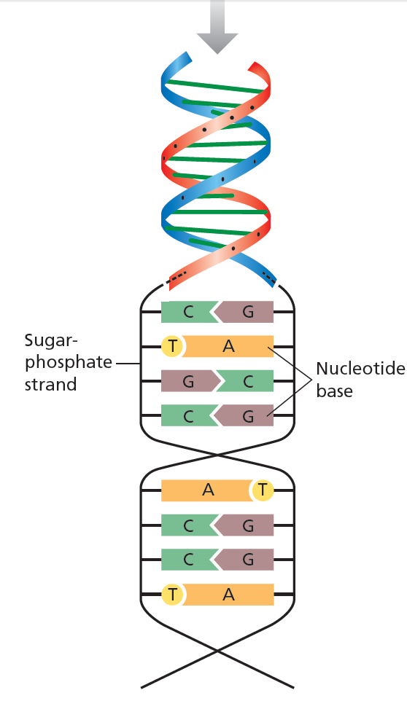
Nucleic Acid
The nucleic acids DNA and RNA are found in the nucleus. A molecule of DNA is composed of two long strands of nucleotides. They are wound around each other to form a double helix.
DNA codes for the production of proteins that carry out and control the many activities within a cell. When a cell divides, new DNA is synthesised.
Each DNA molecule is large. They are too large to move through the nuclear membrane. It is the job of another type of nucleic acid, messenger RNA (mRNA) to transfer the DNA code to the ribosomes for protein synthesis. The order of nucleotides in mRNA is determined by the order of nucleotides in a section of DNA. After synthesis of a strand of mRNA has been completed, it moves from the nucleus to ribosomes in the cytoplasm. The order of nucleotides in the mRNA determines the order of amino acids in protein synthesis.
Notes:
https://www.youtube.com/watch?v=gG7uCskUOrA

Slide 26
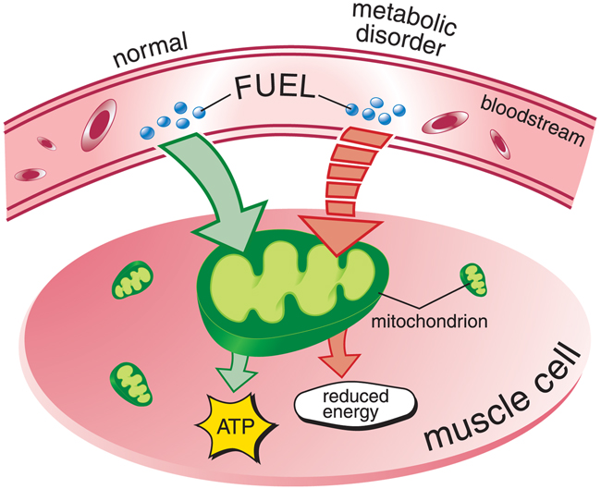
Biochemical Processes
Every living cell of every part of an organism needs matter and energy to keep it alive.
Unicellular organisms take in materials (inputs) from their external environment.
They use these materials inside their single cell.
Outputs or products of these activities are biomolecules and inorganic wastes.
The biomolecules form the structures that carry out tasks.

Slide 27
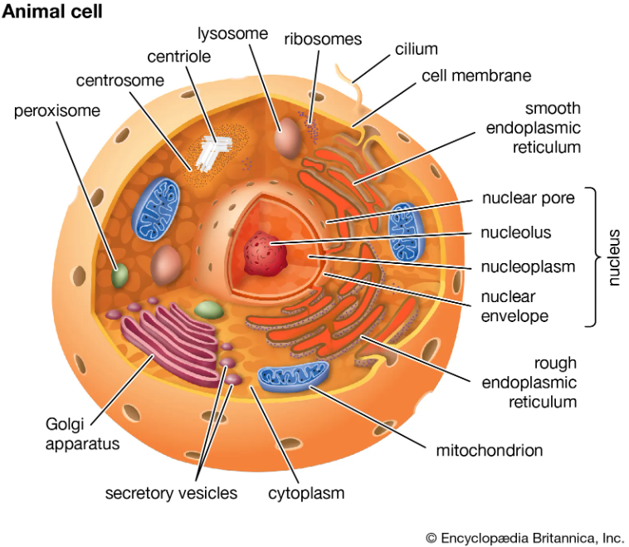
Biochemical Processes
Similar to a factory, compartmentalising a cell by having membrane-bound organelles creates specialised environments for specific functions. A large number of activities can occur at the same time in a very limited space and under different conditions.
For example, chemical reactions in lysosomes break down compounds brought into the cell by using strong digestive enzymes in an acidic environment. Enclosing them in a membrane prevents them destroying the cell.
Specific chemical reactions can occur using only a handful of enzymes that can be concentrated and recycled in membrane-bound areas. Membrane-bound structures can concentrate reactants and store products.

Slide 28
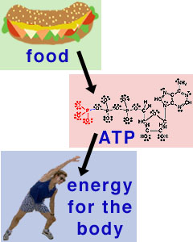
Biochemical Processes
Cellular metabolism is the term used to describe all the chemical reactions that occur in a cell. Thousands of chemical reactions occur constantly in each living cell.
Rate of the reactions varies among organisms.
Metabolic reactions are controlled and regulated to:
  maintain cell functions
  meet the energy needs of the cell.

Slide 29
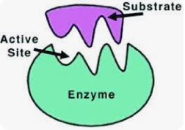
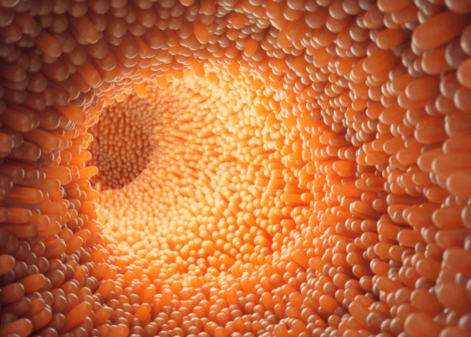
Enzymes
Enzymes control the type and duration of these reactions. They do this by controlling each step in the pathway and speeding up the rate of chemical reactions without undergoing any change itself.
Without enzymes the reactions would occur so slow as to hardly proceed at all.
Intracellular enzymes occur inside cells. They speed up and control metabolic reactions.
Extracellular enzymes are produced by cells. They work outside the cell, e.g. digestive enzymes break down food in the small intestines.

Slide 30
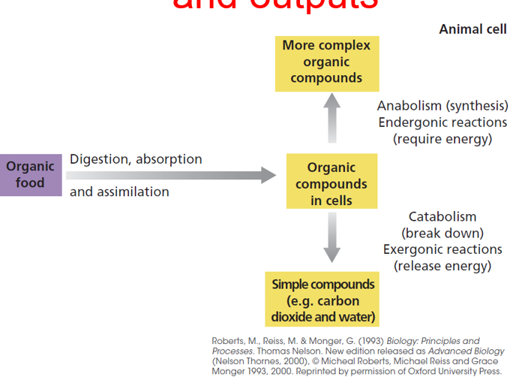
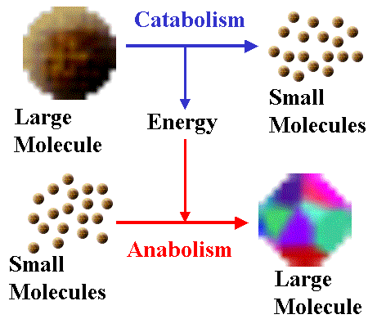
Types of Reactions
Reactions that breakdown complex molecules to simpler fragments are called catabolic reactions. For example, starch polymer breaking down to simple glucose monomers.
Reactions that start with simple molecules to build more complex molecules are called anabolic reactions. For example, amino acids form a polypeptide chain.

Slide 31
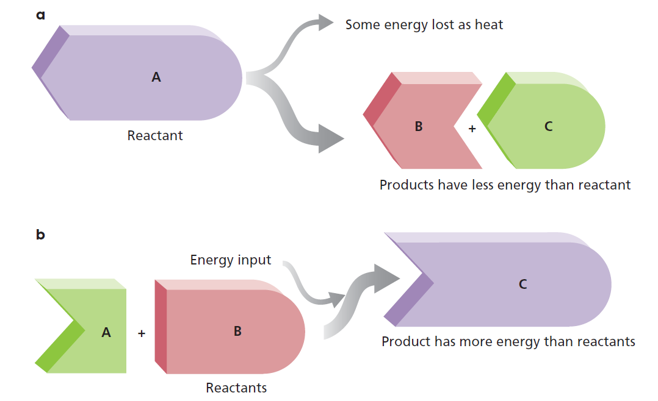
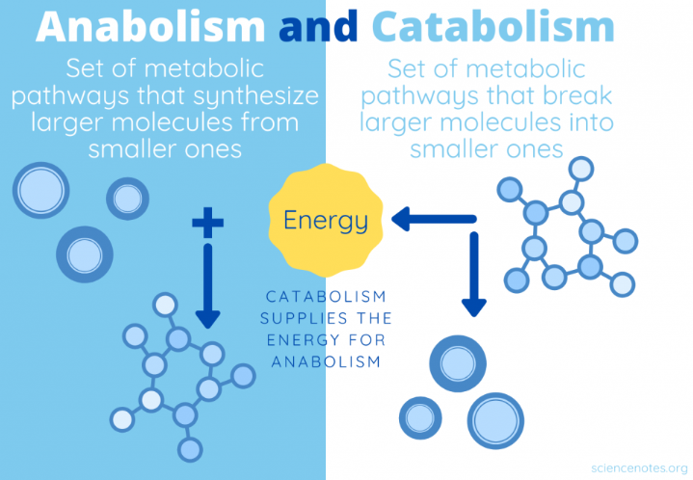
Types of Reactions
Energy is required to make any reaction go. Exergonic reactions (‘exo’ = out) are those that release surplus energy as the reaction forms products. When molecular bonds are broken, energy is released. It makes sense that when a large molecule is broken down to smaller molecules, a large amount of energy is released. Therefore, catabolic reactions are exergonic reactions.
Reactions that require more energy to go are endergonic reaction (‘endo’ = in). When proteins are built up from amino acids, energy is used. Anabolic reactions are always endergonic.
Cells use the available energy released from catabolic reactions to fuel anabolic reactions.

Slide 32
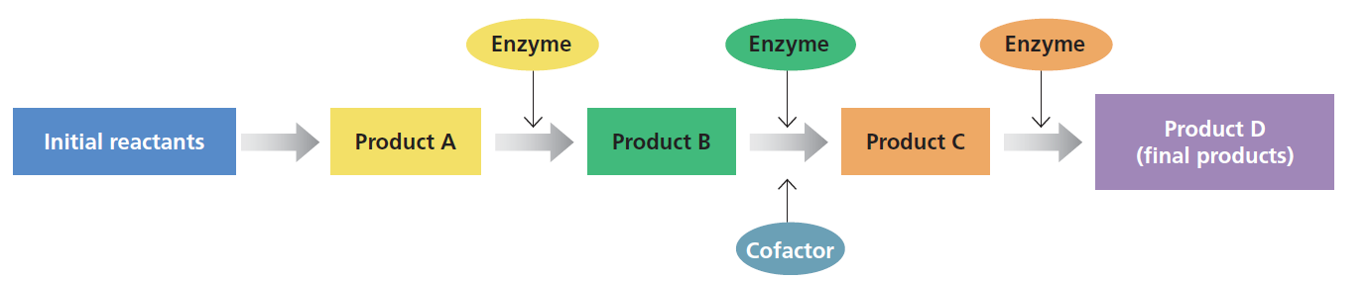
Biochemical Processes
Many cellular processes involve many reaction steps. At each step, reactants react to form new products, which themselves become reactants for the next step in the reaction chain, until the final products are formed.
If products build up and are not removed, the reaction might slow down to the point that the whole pathway is slowed.
Fortunately, the products formed at each step are consumed by the next step in the pathway, or are removed in a variety of ways, ensuring the reactions continue in the right direction.
Photosynthesis and respiration are two pathways controlled and regulated by enzymes.
Notes:
Product from one reaction is continually being removed by becoming the reactant for the next reaction.

Slide 33
Learning Intentions
Understand:
biological molecules are synthesised from monomers to produce complex structures, including carbohydrates, proteins and lipids.
biochemical processes in the cell are controlled by factors, including the nature and arrangement of internal membranes, and the presence of specific enzymes.
Success Criteria
Can you:
Define the terms monomer and polymer.
Explain the chemical composition of proteins, carbohydrates, nucleic acids and lipids and list important biological roles of these macromolecules.
Describe anabolic and catabolic reactions.

Slide 34
Moodle & Textbook Work
Textbook pages 253-256 & 310-312.
Academic Associates Chapter 4.3.
Trial Test 8.
Task due next week!

Slide 35
Student Feedback
What I learnt today…..
What I need to revise….

